Slide 1
ETL Data Pipeline
Isty Wahyu Erlina

Slide 2
BACKGROUND PROJECT
Data
Tim Sales
Tim Product
Tim Data Science

Slide 3
BACKGROUND PROJECT
Sales data
https://hub.docker.com/r/shandytp/amazon-sales-data-docker-db
Marketing data
Berupa CSV
Web Scraping
Scraping Website OLX

Slide 4
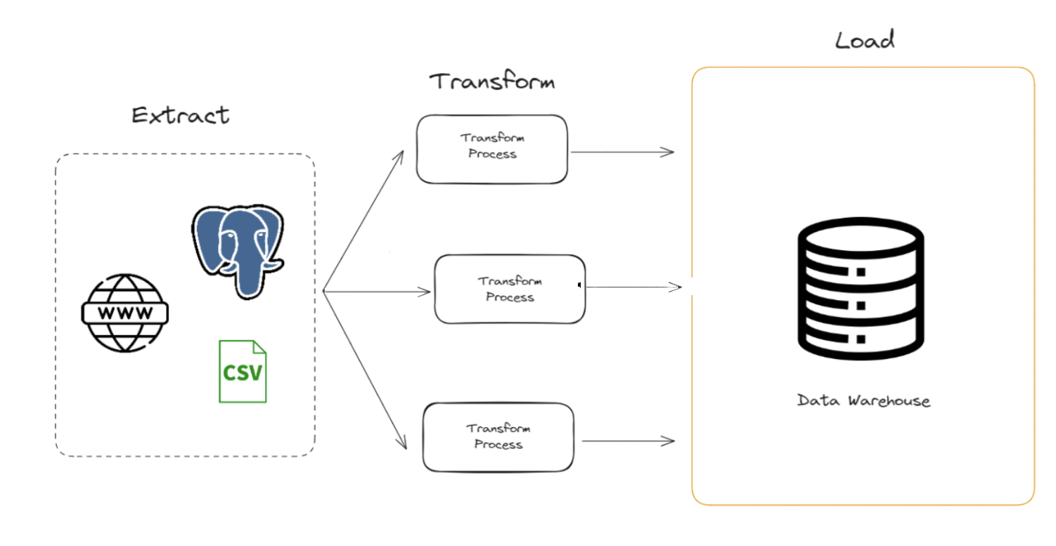
BACKGROUND PROJECT

Slide 5
THANK YOU
Next to practice:
- Scheduler with crontab

